Slide 1
Chapter 4 Mathematical Functions, Characters, and Strings

Slide 2
Mathematical Functions
Java provides many useful methods in the Math class for performing common mathematical functions.

Slide 3
The Math Class
Class constants:
  PI
  E
Class methods:
  Trigonometric Methods
  Exponent Methods
  Rounding Methods
  min, max, abs, and random Methods

Slide 4
Trigonometric Methods
sin(double a)
cos(double a)
tan(double a)
acos(double a)
asin(double a)
atan(double a)
Examples:
Math.sin(0) returns 0.0
Math.sin(Math.PI / 6) returns 0.5
Math.sin(Math.PI / 2) returns 1.0
Math.cos(0) returns 1.0
Math.cos(Math.PI / 6) returns 0.866
Math.cos(Math.PI / 2) returns 0
Radians
toRadians(90)

Slide 5
Exponent Methods
exp(double a)
  Returns e raised to the power of a.
log(double a)
  Returns the natural logarithm of a.
log10(double a)
  Returns the 10-based logarithm of a.
pow(double a, double b)
  Returns a raised to the power of b.
sqrt(double a)
  Returns the square root of a.
Examples:
Math.exp(1) returns 2.71
Math.log(2.71) returns 1.0
Math.pow(2, 3) returns 8.0
Math.pow(3, 2) returns 9.0
Math.pow(3.5, 2.5) returns 22.91765
Math.sqrt(4) returns 2.0
Math.sqrt(10.5) returns 3.24

Slide 6
Rounding Methods
double ceil(double x)
  x rounded up to its nearest integer. This integer is returned as a double value.
double floor(double x)
  x is rounded down to its nearest integer. This integer is returned as a double value.
double rint(double x)
  x is rounded to its nearest integer. If x is equally close to two integers, the even one is returned as a double.
int round(float x)
  Return (int)Math.floor(x+0.5).
long round(double x)
  Return (long)Math.floor(x+0.5).

Slide 7
Rounding Methods Examples
Math.ceil(2.1) returns 3.0
Math.ceil(2.0) returns 2.0
Math.ceil(-2.0) returns –2.0
Math.ceil(-2.1) returns -2.0
Math.floor(2.1) returns 2.0
Math.floor(2.0) returns 2.0
Math.floor(-2.0) returns –2.0
Math.floor(-2.1) returns -3.0
Math.rint(2.1) returns 2.0
Math.rint(2.0) returns 2.0
Math.rint(-2.0) returns –2.0
Math.rint(-2.1) returns -2.0
Math.rint(2.5) returns 2.0
Math.rint(-2.5) returns -2.0
Math.round(2.6f) returns 3
Math.round(2.0) returns 2
Math.round(-2.0f) returns -2
Math.round(-2.6) returns -3

Slide 8
min, max, and abs
max(a, b)and min(a, b)
  Returns the maximum or minimum of two parameters.
abs(a)
  Returns the absolute value of the parameter.
random()
  Returns a random double value
  in the range [0.0, 1.0).
Examples:
Math.max(2, 3) returns 3
Math.max(2.5, 3) returns 3.0
Math.min(2.5, 3.6) returns 2.5
Math.abs(-2) returns 2
Math.abs(-2.1) returns 2.1

Slide 9

The random Method
Generates a random double value greater than or equal to 0.0 and less than 1.0 (0 <= Math.random() < 1.0).
Examples:
In general,

Slide 10
Character Data Type
Four hexadecimal digits.
char letter = 'A'; (ASCII)
char numChar = '4'; (ASCII)
char letter = '\u0041'; (Unicode)
char numChar = '\u0034'; (Unicode)
NOTE: The increment and decrement operators can also be used on char variables to get the next or preceding Unicode character. For example, the following statements display character b.
  char ch = 'a';
  System.out.println(++ch);

Slide 11

Unicode Format
Java characters use Unicode, a 16-bit encoding scheme established by the Unicode Consortium to support the interchange, processing, and display of written texts in the world’s diverse languages. Unicode takes two bytes, preceded by \u, expressed in four hexadecimal numbers that run from '\u0000' to '\uFFFF'. So, Unicode can represent 65535 + 1 characters.
Unicode \u03b1 \u03b2 \u03b3 for three Greek letters

Slide 12
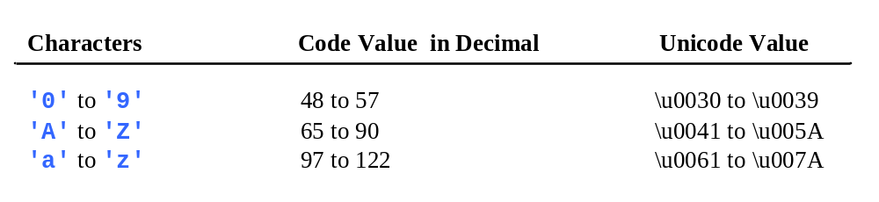
ASCII Code for Commonly Used Characters

Slide 13
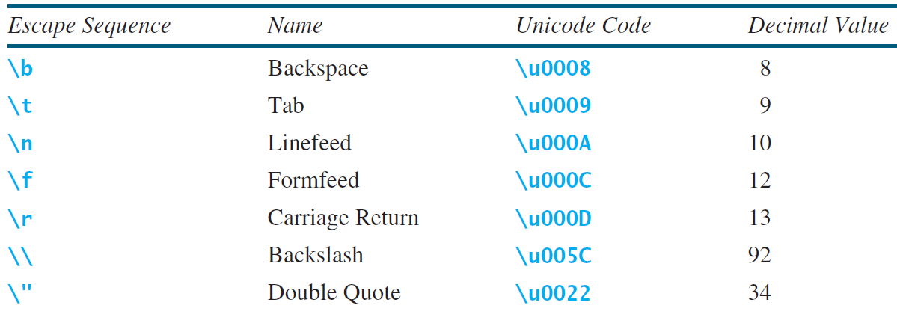
Escape Sequences for Special Characters

Slide 14

Appendix B: ASCII Character Set
ASCII Character Set is a subset of the Unicode from \u0000 to \u007f

Slide 15

ASCII Character Set, cont.
ASCII Character Set is a subset of the Unicode from \u0000 to \u007f

Slide 16
Casting between char and Numeric Types
int i = 'a'; // Same as int i = (int)'a';
char c = 97; // Same as char c = (char)97;

Slide 17
Comparing and Testing Characters
if (ch >= 'A' && ch <= 'Z')
System.out.println(ch + " is an uppercase letter");
else if (ch >= 'a' && ch <= 'z')
System.out.println(ch + " is a lowercase letter");
else if (ch >= '0' && ch <= '9')
System.out.println(ch + " is a numeric character");

Slide 18
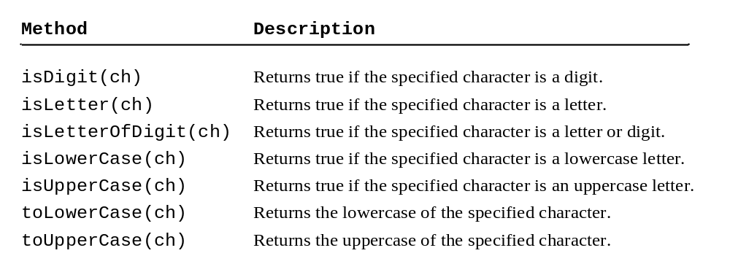
Methods in the Character Class

Slide 19
Reading a char
System.out.print("Enter a character: ");
char ch = input.next().charAt(0);
System.out.println("You entered: " + ch);

